Slide 1
Introduction to Optical Networks

Slide 2
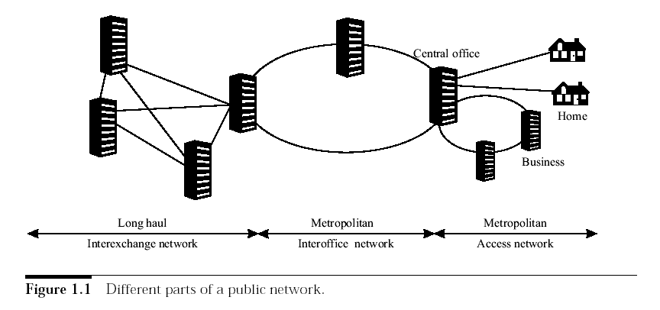
Telecommunications Network Architecture

Slide 3
Telecommunications Network Architecture
Metro network: lie within a city or a region
  Access network: extend from a central office to businesses and homes
  Interoffice network: connect central offices within a city or a region
Long-haul network: interconnect cities or regions

Slide 4
Desired Features of Telecommunications Networks
High capacity
Efficiently support data traffic
  Use packet switching
Deliver new and flexible types of services
  Bandwidth on demand
  Restorable connections with different restoration guarantees

Slide 5
Optical Networks
Optical fibers as transmission media
  High bandwidth: tens of Tbps
  Low loss and low bit error rate
Two ways to increase the transmission capacity on a fiber:
  Increase the bit rate with time division multiplexing (TDM): many lower speed data streams are multiplexed into a higher-speed stream
  Wavelength division multiplexing (WDM): transmit data simultaneously at multiple wavelengths
TDM and WDM combined: tens of Tbps

Slide 6
Optical Networks
Two generations
  First generation: switching and processing done by electronics
    SONET
  Second generation: routing and switching done in optical domain
    Wavelength routing networks

Slide 7
Synchronous Optical Network (SONET)
The ANSI standard for synchronous data transmission on optical media.
Provide end-to-end circuit-switched connections
Provide efficient mechanism for multiplexing low-speed connections into higher-speed connections
  Define a base rate of 51.84 Mbps and a set of multiples of the base rate known as "Optical Carrier levels (OCx)"
Provide efficient way to extract low-speed streams from a high-speed stream at intermediate nodes
High availability (99.99% to 99.999%)
  Rapid service restoration in the event of failures
Notes:
The percentage of time the service is available

Slide 8
SONET Transmission Rates
OC-1 = 51.84 Mbps
OC-3 = 155.52 Mbps
OC-12 = 622.08 Mbps
OC-24 = 1.244 Gbps
OC-48 = 2.488 Gbps
OC-192 = 9.953 Gbps
OC-768 = 39.814 Gbps

Slide 9
SONET Elements
Terminal multiplexers (TMs): nodes at the ends of point-to-point links, multiplex and demultiplex traffic streams
Add/drop multiplexers (ADMs):drop/add one or more low-speed streams from/to a high-speed stream, allow the remaining traffic to pass through
  Deployed in linear and ring networks
Digital crossconnects (DCSs): large number of ports, extract and switch lower-speed streams (44.736Mbps and 1.544Mbps), interconnect SONET rings
Notes:
P270 0f old book

Slide 10
Wavelength Routing Networks
Optical layer provides lightpath services to client layers (e.g. IP, ATM, SONET)
Lightpath: a circuit switched connection between two nodes set up by assigning a dedicated wavelength on each link in its path
  All links in the path must be assigned the same wavelength if network nodes are not capable of wavelength conversion
  Wavelength conversion can reduce connection blocking
Notes:
Light path and conversion examples

Slide 11
Lightpath Service
Transparent to bit rate and protocol format
Advantages
  Service transparency: can provide different services using a single infrastructure
  Future-proof: allow new services to be deployed rapidly

Slide 12
Network Elements
Optical line terminals (OLTs):
  multiplex multiple wavelengths into a single fiber
  demultiplex wavelengths on a single fiber into separate wavelengths
Optical add/drop multiplexers (OADMs):
  drop/add one or more wavelengths from/to a composite WDM signal, allow the remaining wavelengths to pass through
  two line ports and a number of local ports
Optical crossconnects (OXCs):
  switch wavelengths from one port to another
  large number of ports

Slide 13
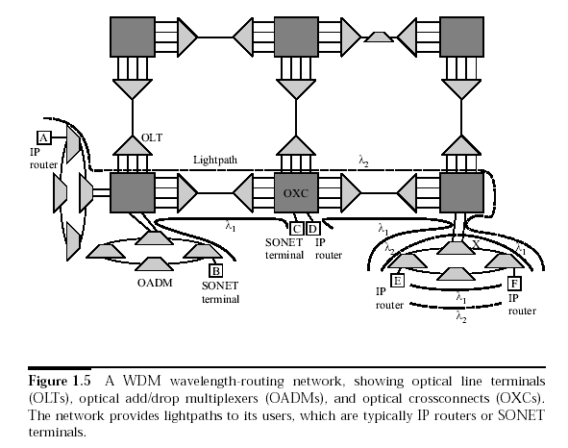

Slide 14
Advantages of
Wavelength Routing
Reduce costs (switch ports, electronic processing) at the client layer by routing pass-through traffic in the optical layer
Support different traffic patterns

Slide 15
Future Services
Packet switched virtual circuit service
  Connection bandwidth can be smaller than the full bandwidth on a wavelength
Datagram service: transmit packets without setting up connections

Slide 16
Optical Packet Switching
Not feasible at present due to
  Lack of optical buffers
  Limited processing capabilities in the optical domain
  Primitive stage of fast optical-switching technology

